Slide 1
Operating System
Lecture 14: Virtual Memory
Manoj Kumar Jain
M.L. Sukhadia University Udaipur

Slide 2
Chapter 10: Virtual Memory
Demand Paging
Page Replacement
Thrashing
Manoj Kumar Jain Professor Computer Science MLSU Udaipur

Slide 3
Demand Paging
Bring a page into memory only when it is needed.
  Less I/O needed
  Less memory needed
  Faster response
  More users
Page is needed ⇒ reference to it
  invalid reference ⇒ abort
  not-in-memory ⇒ bring to memory
Manoj Kumar Jain Professor Computer Science MLSU Udaipur

Slide 4
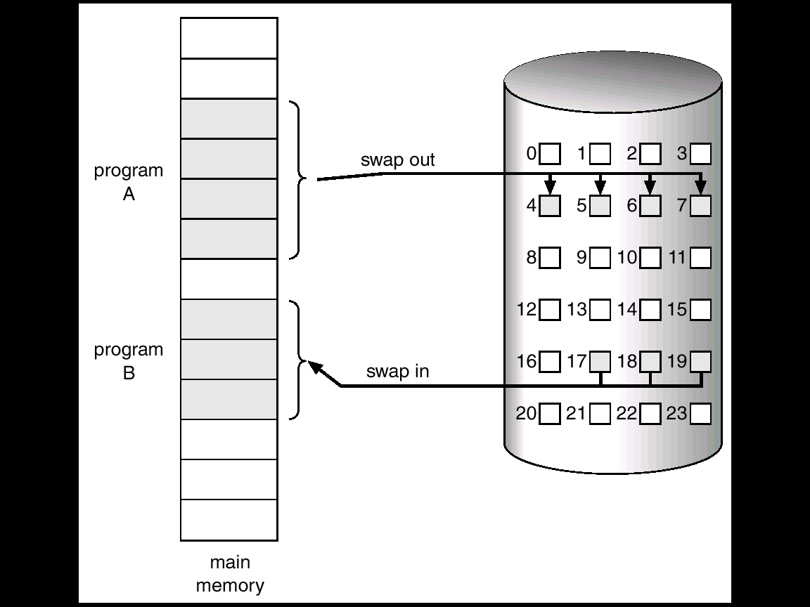
Transfer of a Paged Memory to Contiguous Disk Space
Manoj Kumar Jain Professor Computer Science MLSU Udaipur

Slide 5
Valid-Invalid Bit
With each page table entry a valid–invalid bit is associated
(1 ⇒ in-memory, 0 ⇒ not-in-memory)
Initially valid–invalid but is set to 0 on all entries.
Example of a page table snapshot.
During address translation, if valid–invalid bit in page table entry is 0 ⇒ page fault.
Frame #
valid-invalid bit
1
1
1
1
0

0
0
page table
Manoj Kumar Jain Professor Computer Science MLSU Udaipur

Slide 6

Page Table When Some Pages Are Not in Main Memory
Manoj Kumar Jain Professor Computer Science MLSU Udaipur

Slide 7
Page Fault
If there is ever a reference to a page, first reference will trap to
OS ⇒ page fault
OS looks at another table to decide:
  Invalid reference ⇒ abort.
  Just not in memory.
Get empty frame.
Swap page into frame.
Reset tables, validation bit = 1.
Restart instruction: Least Recently Used
  block move
  auto increment/decrement location
Manoj Kumar Jain Professor Computer Science MLSU Udaipur

Slide 8

Steps in Handling a Page Fault
Manoj Kumar Jain Professor Computer Science MLSU Udaipur

Slide 9
What happens if there is no free frame?
Page replacement – find some page in memory, but not really in use, swap it out.
  algorithm
  performance – want an algorithm which will result in minimum number of page faults.
Same page may be brought into memory several times.
Manoj Kumar Jain Professor Computer Science MLSU Udaipur

Slide 10
Performance of Demand Paging
Page Fault Rate 0 ≤ p ≤ 1.0
  if p = 0 no page faults
  if p = 1, every reference is a fault
Effective Access Time (EAT)
EAT = (1 – p) x memory access
+ p (page fault overhead
+ [swap page out ]
+ swap page in
+ restart overhead)
Manoj Kumar Jain Professor Computer Science MLSU Udaipur

Slide 11
Demand Paging Example
Memory access time = 1 microsecond
50% of the time the page that is being replaced has been modified and therefore needs to be swapped out.
Swap Page Time = 10 msec = 10,000 msec
EAT = (1 – p) x 1 + p (15000)
1 + 15000P (in msec)
Manoj Kumar Jain Professor Computer Science MLSU Udaipur

Slide 12
Page Replacement Algorithms
Want lowest page-fault rate.
Evaluate algorithm by running it on a particular string of memory references (reference string) and computing the number of page faults on that string.
In all our examples, the reference string is
1, 2, 3, 4, 1, 2, 5, 1, 2, 3, 4, 5.
Manoj Kumar Jain Professor Computer Science MLSU Udaipur

Slide 13

Graph of Page Faults Versus The Number of Frames
Manoj Kumar Jain Professor Computer Science MLSU Udaipur

Slide 14
First-In-First-Out (FIFO) Algorithm
Reference string: 1, 2, 3, 4, 1, 2, 5, 1, 2, 3, 4, 5
3 frames (3 pages can be in memory at a time per process)
4 frames
FIFO Replacement – Belady’s Anomaly
  more frames ⇒ less page faults
1
1
4
5
2
2
1
3
9 page faults
3
3
2
4
1
1
5
4
2
2
1
5
10 page faults
3
3
2
4
4
3
Manoj Kumar Jain Professor Computer Science MLSU Udaipur

Slide 15
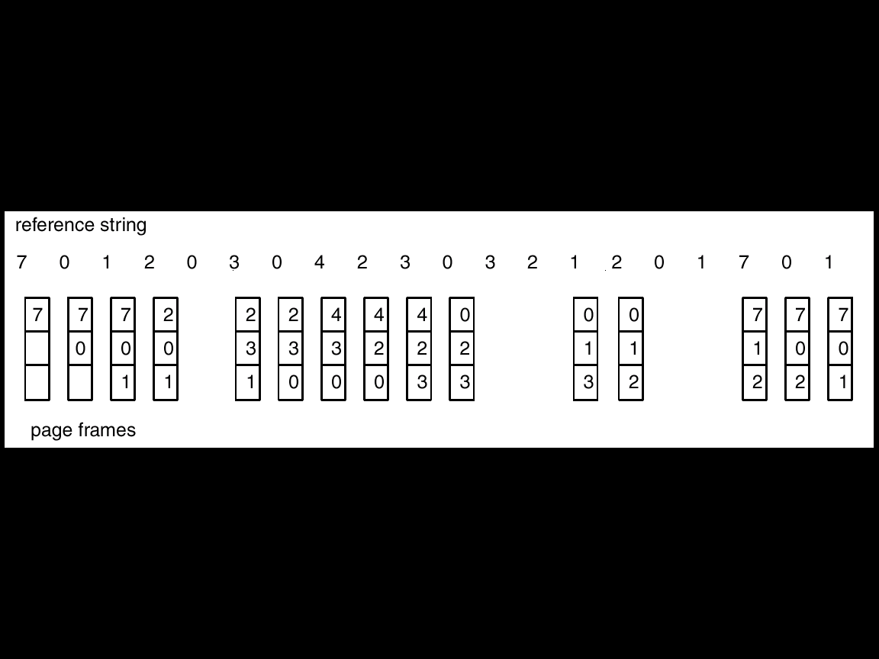
FIFO Page Replacement
Manoj Kumar Jain Professor Computer Science MLSU Udaipur

Slide 16

FIFO Illustrating Belady’s Anamoly
Manoj Kumar Jain Professor Computer Science MLSU Udaipur

Slide 17
Optimal Algorithm
Replace page that will not be used for longest period of time.
4 frames example
1, 2, 3, 4, 1, 2, 5, 1, 2, 3, 4, 5
How do you know this?
Used for measuring how well your algorithm performs.
1
4
2
6 page faults
3
4
5
Manoj Kumar Jain Professor Computer Science MLSU Udaipur

Slide 18
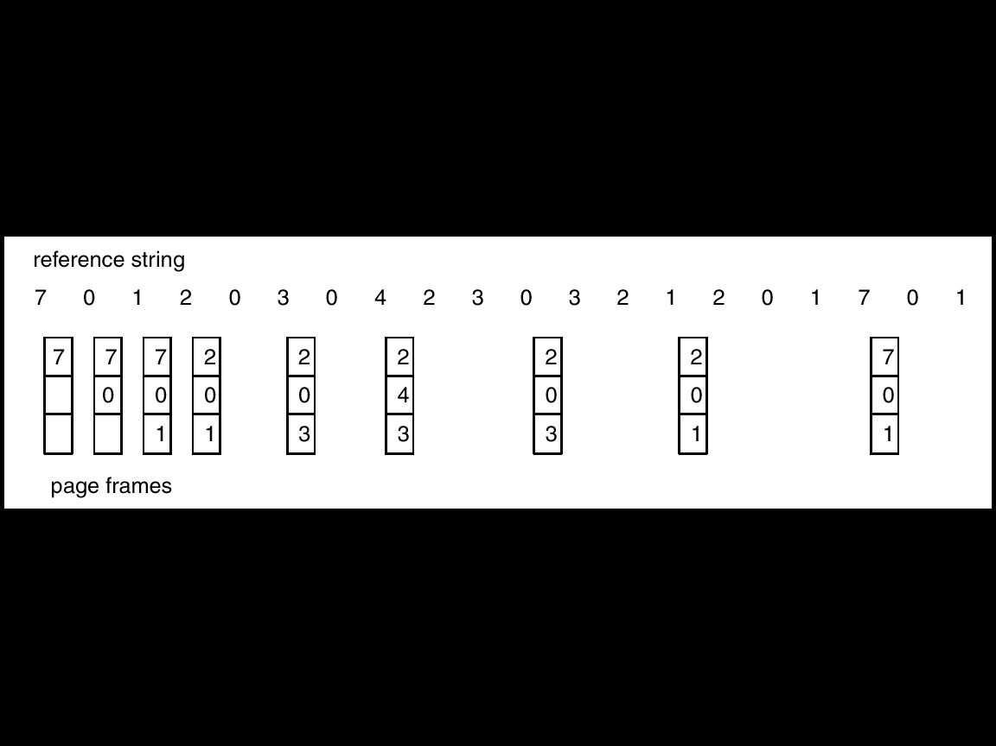
Optimal Page Replacement
Manoj Kumar Jain Professor Computer Science MLSU Udaipur

Slide 19
Least Recently Used (LRU) Algorithm
Reference string: 1, 2, 3, 4, 1, 2, 5, 1, 2, 3, 4, 5
Counter implementation
  Every page entry has a counter; every time page is referenced through this entry, copy the clock into the counter.
  When a page needs to be changed, look at the counters to determine which are to change.
1
5
2
4
3
5
4
3
Manoj Kumar Jain Professor Computer Science MLSU Udaipur

Slide 20
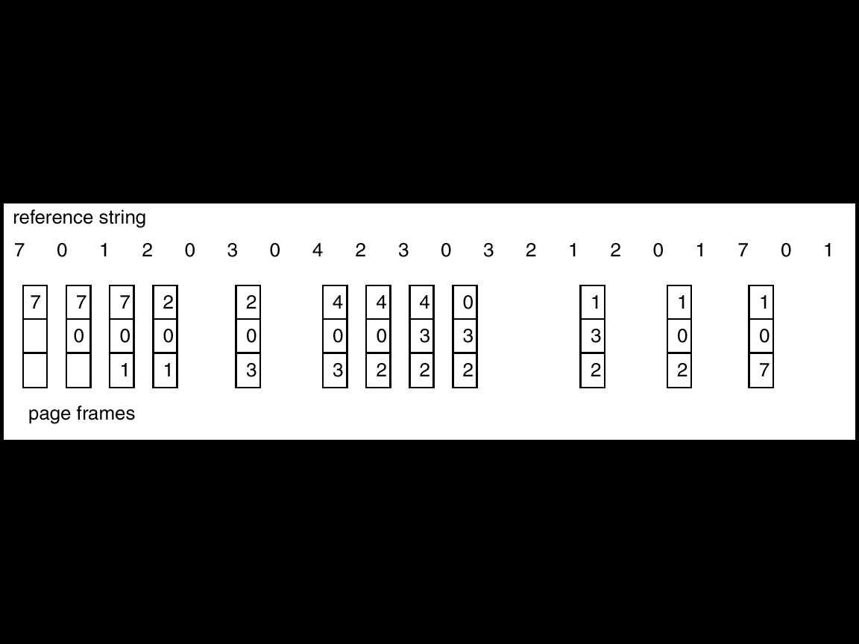
LRU Page Replacement
Manoj Kumar Jain Professor Computer Science MLSU Udaipur

Slide 21
LRU Algorithm (Cont.)
Stack implementation – keep a stack of page numbers in a double link form:
  Page referenced:
    move it to the top
    requires 6 pointers to be changed
  No search for replacement
Manoj Kumar Jain Professor Computer Science MLSU Udaipur

Slide 22
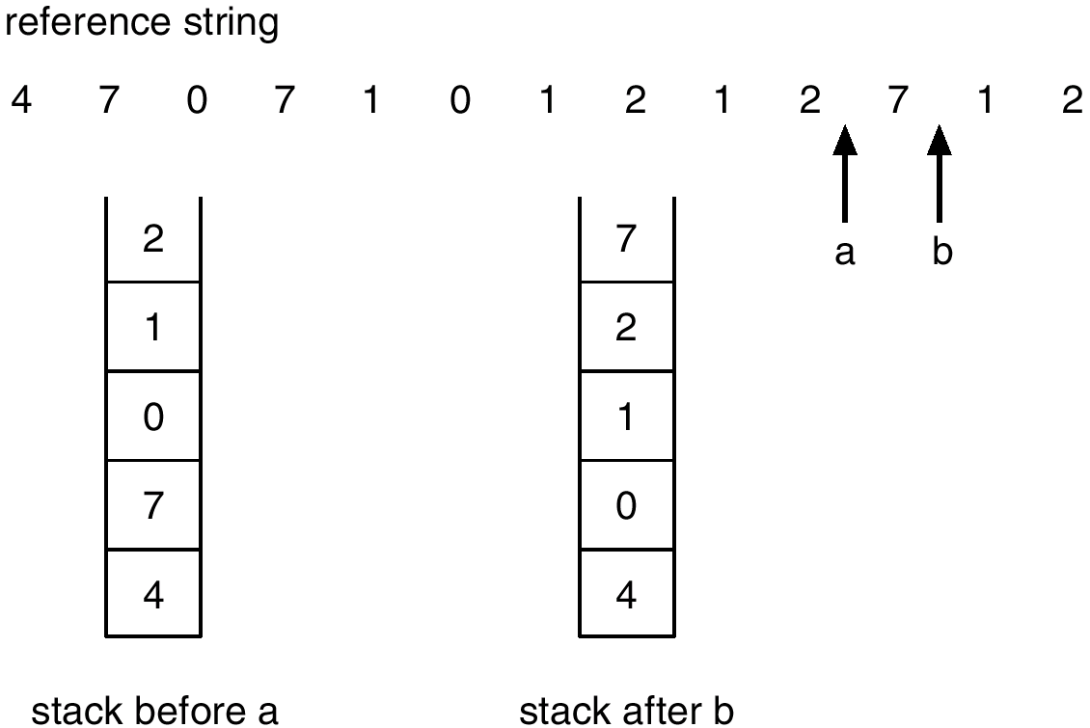
Use Of A Stack to Record The Most Recent Page References
Manoj Kumar Jain Professor Computer Science MLSU Udaipur

Slide 23
LRU Approximation Algorithms
Reference bit
  With each page associate a bit, initially = 0
  When page is referenced bit set to 1.
  Replace the one which is 0 (if one exists). We do not know the order, however.
Second chance
  Need reference bit.
  Clock replacement.
  If page to be replaced (in clock order) has reference bit = 1. then:
    set reference bit 0.
    leave page in memory.
    replace next page (in clock order), subject to same rules.
Manoj Kumar Jain Professor Computer Science MLSU Udaipur

Slide 24

Second-Chance (clock) Page-Replacement Algorithm
Manoj Kumar Jain Professor Computer Science MLSU Udaipur

Slide 25
Counting Algorithms
Keep a counter of the number of references that have been made to each page.
LFU Algorithm: replaces page with smallest count.
MFU Algorithm: based on the argument that the page with the smallest count was probably just brought in and has yet to be used.
Manoj Kumar Jain Professor Computer Science MLSU Udaipur

Slide 26
Thrashing
If a process does not have “enough” pages, the page-fault rate is very high. This leads to:
  low CPU utilization.
  operating system thinks that it needs to increase the degree of multiprogramming.
  another process added to the system.
Thrashing ≡ a process is busy swapping pages in and out.
Manoj Kumar Jain Professor Computer Science MLSU Udaipur

Slide 27

Thrashing
Why does paging work?
Locality model
  Process migrates from one locality to another.
  Localities may overlap.
Why does thrashing occur?
Σ size of locality > total memory size
Manoj Kumar Jain Professor Computer Science MLSU Udaipur

Slide 28
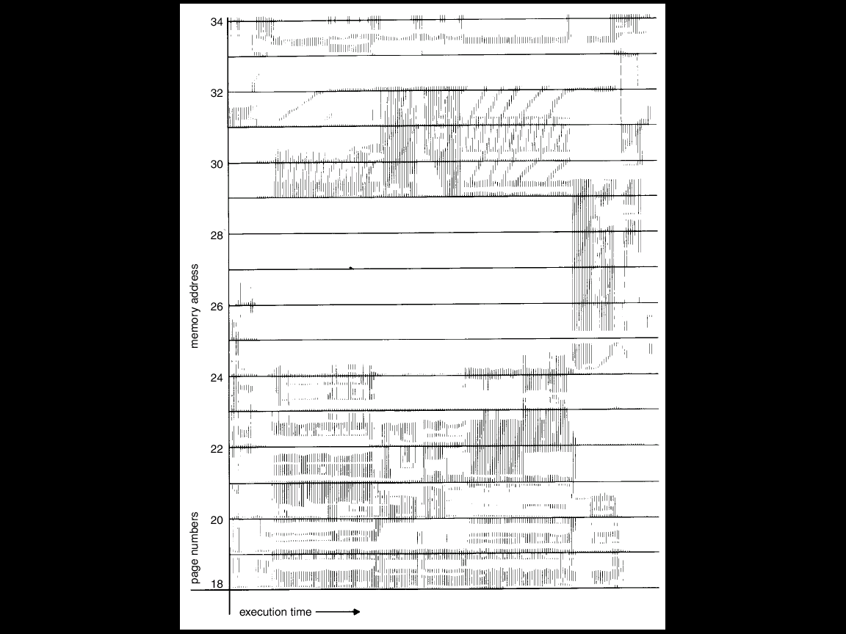
Locality In A Memory-Reference Pattern
Manoj Kumar Jain Professor Computer Science MLSU Udaipur

Slide 29
Working-Set Model
Δ ≡ working-set window ≡ a fixed number of page references
Example: 10,000 instruction
WSS_{i} (working set of Process P_{i}) =
total number of pages referenced in the most recent Δ (varies in time)
  if Δ too small will not encompass entire locality.
  if Δ too large will encompass several localities.
  if Δ = ∞ ⇒ will encompass entire program.
D = Σ WSS_{i} ≡ total demand frames
if D > m ⇒ Thrashing
Policy if D > m, then suspend one of the processes.
Manoj Kumar Jain Professor Computer Science MLSU Udaipur

Slide 30

Working-set model
Manoj Kumar Jain Professor Computer Science MLSU Udaipur

Slide 31
Keeping Track of the Working Set
Approximate with interval timer + a reference bit
Example: Δ = 10,000
  Timer interrupts after every 5000 time units.
  Keep in memory 2 bits for each page.
  Whenever a timer interrupts copy and sets the values of all reference bits to 0.
  If one of the bits in memory = 1 ⇒ page in working set.
Why is this not completely accurate?
Improvement = 10 bits and interrupt every 1000 time units.
Manoj Kumar Jain Professor Computer Science MLSU Udaipur

Slide 32

Page-Fault Frequency Scheme
Establish “acceptable” page-fault rate.
  If actual rate too low, process loses frame.
  If actual rate too high, process gains frame.
Manoj Kumar Jain Professor Computer Science MLSU Udaipur

Slide 33
Other Considerations
Prepaging
Page size selection
  fragmentation
  table size
  I/O overhead
  locality
Manoj Kumar Jain Professor Computer Science MLSU Udaipur

Slide 34
Other Considerations (Cont.)
TLB Reach - The amount of memory accessible from the TLB.
TLB Reach = (TLB Size) X (Page Size)
Ideally, the working set of each process is stored in the TLB. Otherwise there is a high degree of page faults.
Manoj Kumar Jain Professor Computer Science MLSU Udaipur

Slide 35
Increasing the Size of the TLB
Increase the Page Size. This may lead to an increase in fragmentation as not all applications require a large page size.
Provide Multiple Page Sizes. This allows applications that require larger page sizes the opportunity to use them without an increase in fragmentation.
Manoj Kumar Jain Professor Computer Science MLSU Udaipur

Slide 36
Other Considerations (Cont.)
Program structure
  int A[][] = new int[1024][1024];
  Each row is stored in one page
  Program 1 for (j = 0; j < A.length; j++)
  for (i = 0; i < A.length; i++)
  A[i,j] = 0;
  1024 x 1024 page faults
  Program 2 for (i = 0; i < A.length; i++)
  for (j = 0; j < A.length; j++)
  A[i,j] = 0;
  1024 page faults (assuming page size 1024 words)
Manoj Kumar Jain Professor Computer Science MLSU Udaipur

Slide 37
Other Considerations (Cont.)
I/O Interlock – Pages must sometimes be locked into memory.
Consider I/O. Pages that are used for copying a file from a device must be locked from being selected for eviction by a page replacement algorithm.
Manoj Kumar Jain Professor Computer Science MLSU Udaipur

Slide 38
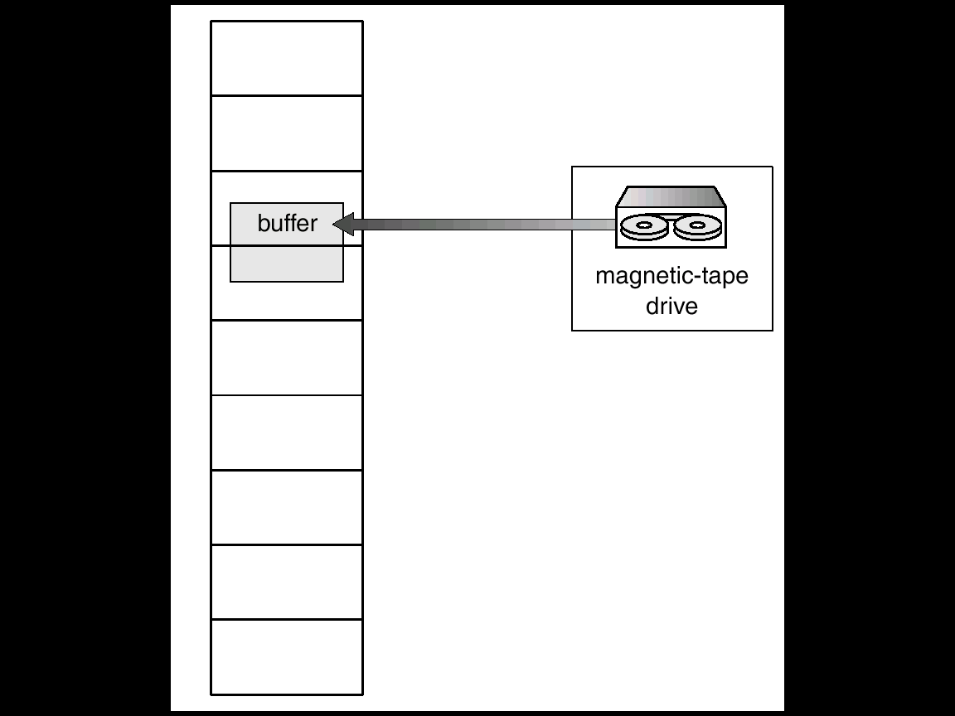
Reason Why Frames Used For I/O Must Be In Memory
Manoj Kumar Jain Professor Computer Science MLSU Udaipur

Slide 39
Thanks
Manoj Kumar Jain Professor Computer Science MLSU Udaipur

